Slide 1
Recommendation system for restaurants

Slide 2
EDA Results
Apsara ice cream and Hotley Smokey has top 2 highest value count of data set
57 % of restaurants take online orders
86.9% restaurants have facility of booking table
New and 3.8 category have highest value count and 4.8,4.9 rating restaurant are very less
For 387 rows having 0 votes and for 50 rows have 4 votes and 84 rows have least votes
We Seen that Top 3 locations have good amount for restaurants are BTM,JP Nagar , HSR
We had Seen That Those restaurants having high value count having type of Quick Bites, Casual Dinning, Café
Max Dishes like are –Biryani,Paratha, Appam, Chicken Curry,Passion,Fruit,Juice,Crepe , Chicken Biryani etc
Top 3 type of cuisines are –North Indian ,North indian and Chinese, South Indian
We See that 300,400,500 are approx. cost for 2 people
We Seen That In menu items for max restaurants have chicken,veg,rice etc
We Seen That In City BTM, Koramangala 6th Block, Koramangala 5th Block have highest value
We Seen that provided rate vary with location for same restaurant

Slide 3
Steps We Do
1)We Seen That rating Columns Have More than 10 % values missing and values available have Unknown category New , So we decided to extract rating from reviews by name reviews_ratings
2) We Do some Preprocessing and cleaning of text data ,like steming ,tokenizing,stop word removal and convert into vector form
3) We Created Sparse Matrix based on reviews, location,cuisines,approx_cost for two people,rest type, list in city
4) and Apply Ml model that predict top 5 restaurant

Slide 4

Attributes given
'name’,
'online_order’,
'book_table’,
'rate’,
'votes’,
'location’,
'rest_type’,
'dish_liked’,
'cuisines’,
'approx_cost(for two people)’,
'reviews_list’,
'menu_item’,
'listed_in(type)’,
'listed_in(city)’,
'reviews_rating'
Shape of DataSet

Slide 5
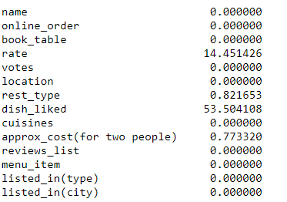
Missing values
Rate and Dish liked Have ore than 10% values missing

Slide 6
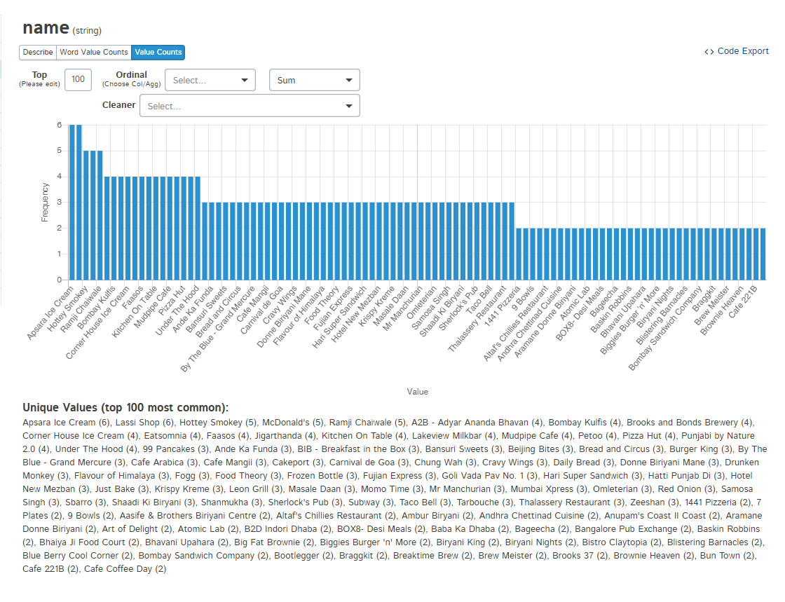
EDA For EachAttributes/ name of rest
Apsara ice cream and Hotley Smokey has top 2 highest value count of data set

Slide 7
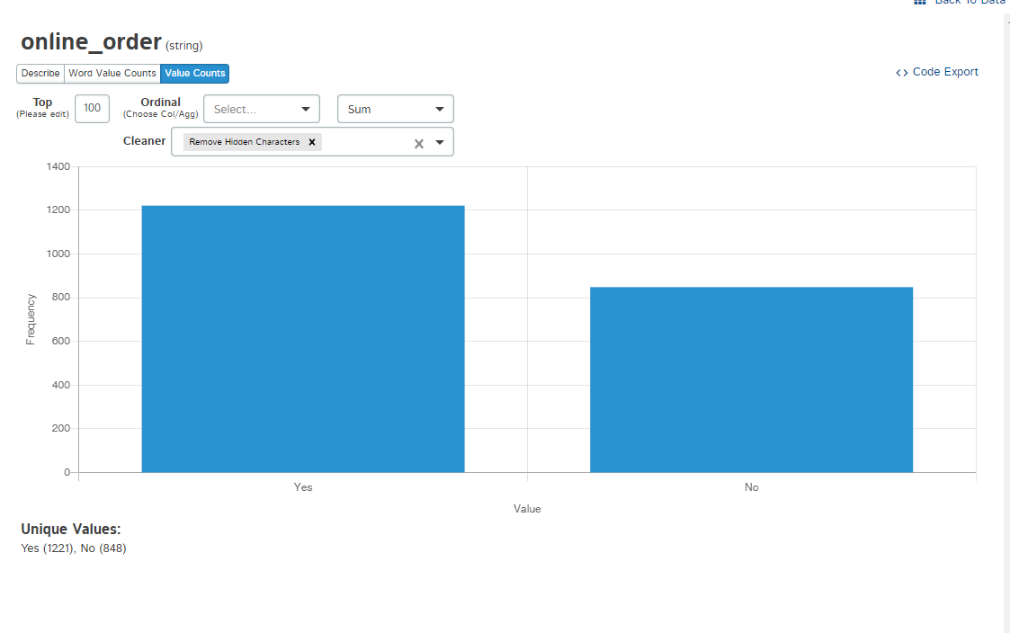
Online Order
57 % of restaurants take online orders

Slide 8
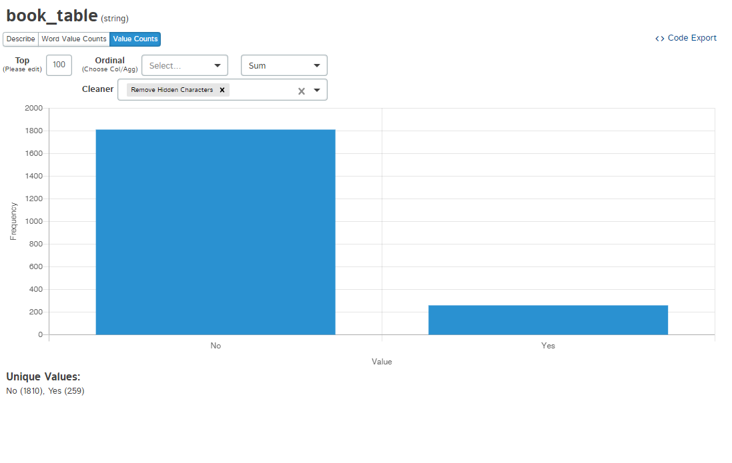
Book table
86.9% restaurants have facility of booking table

Slide 9
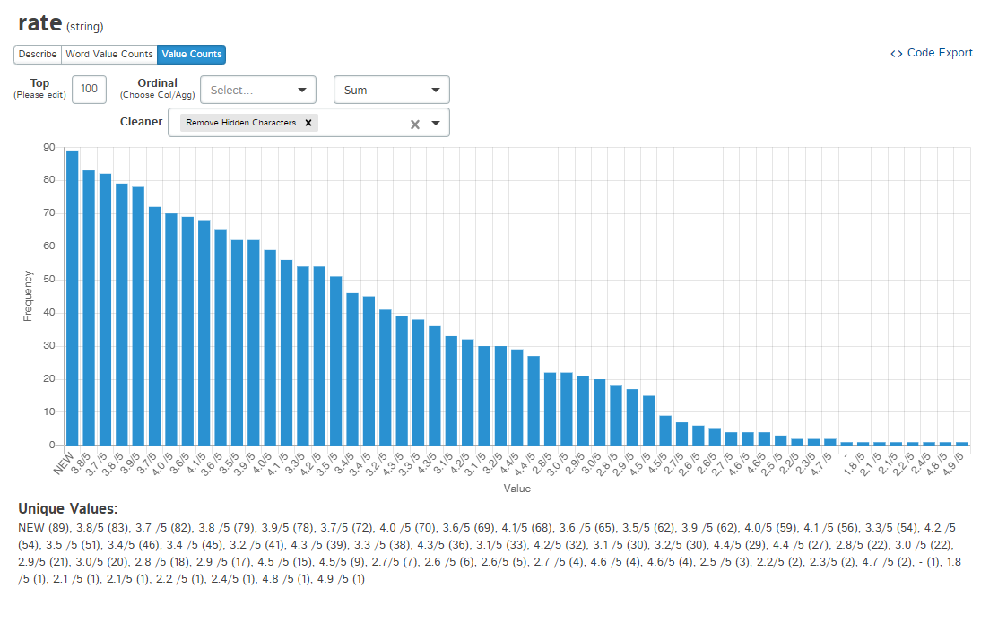
rate
New and 3.8 category have highest value count and 4.8,4.9 rating restaurant are very less

Slide 10
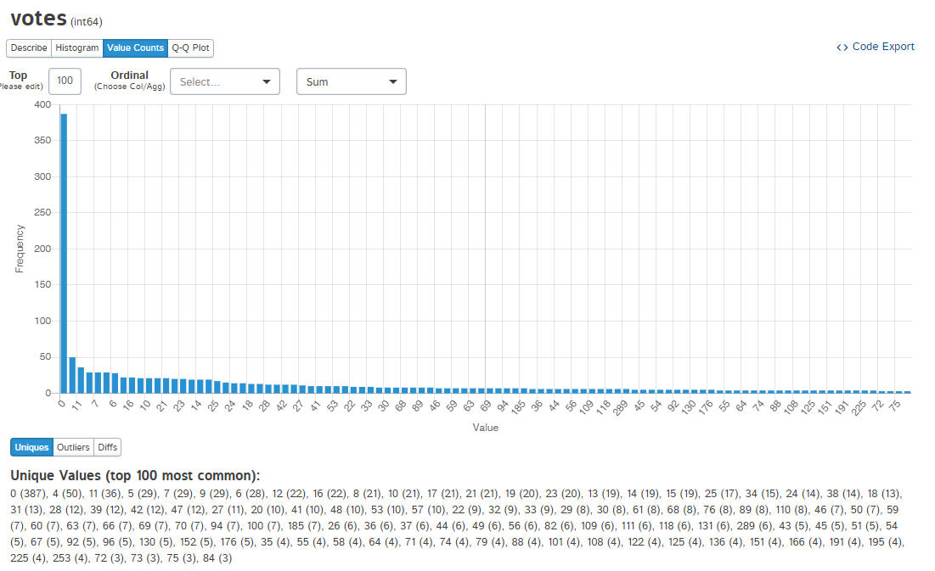
Votes
For 387 rows having 0 votes and for 50 restaurants have 4 votes and 84 rows have least votes

Slide 11
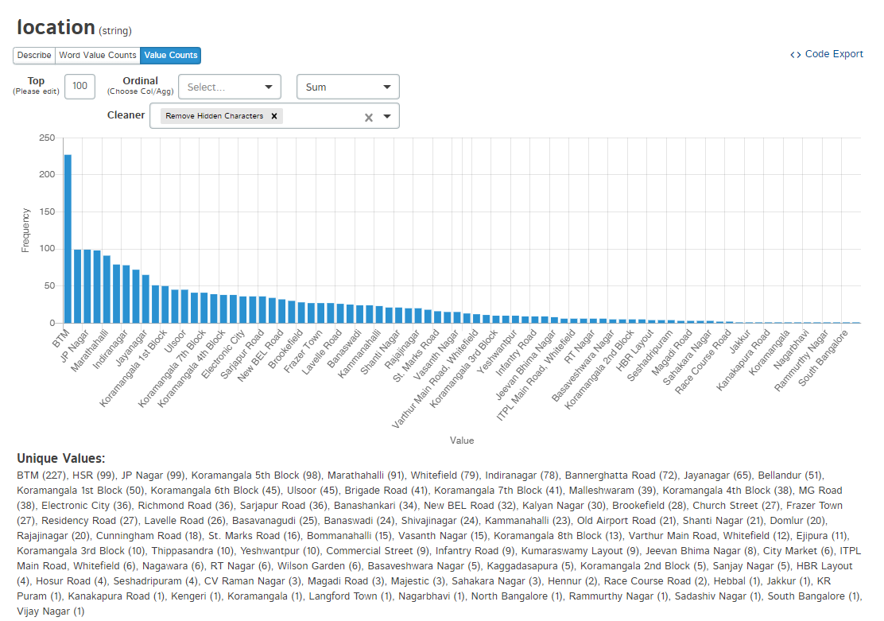
Location
We Seen that Top 3 locations have good amount for restaurants are BTM,JP Nagar , HSR

Slide 12
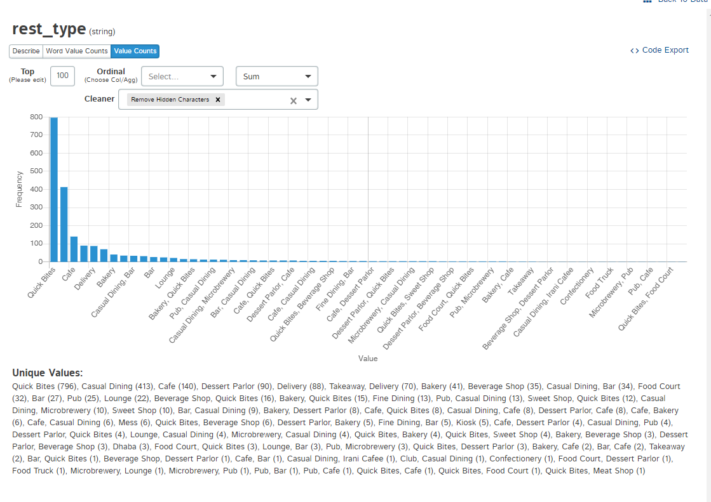
Rest type
We had Seen That Those restaurants having high value count having type of Quick Bites, Casual Dinning, Cafe

Slide 13
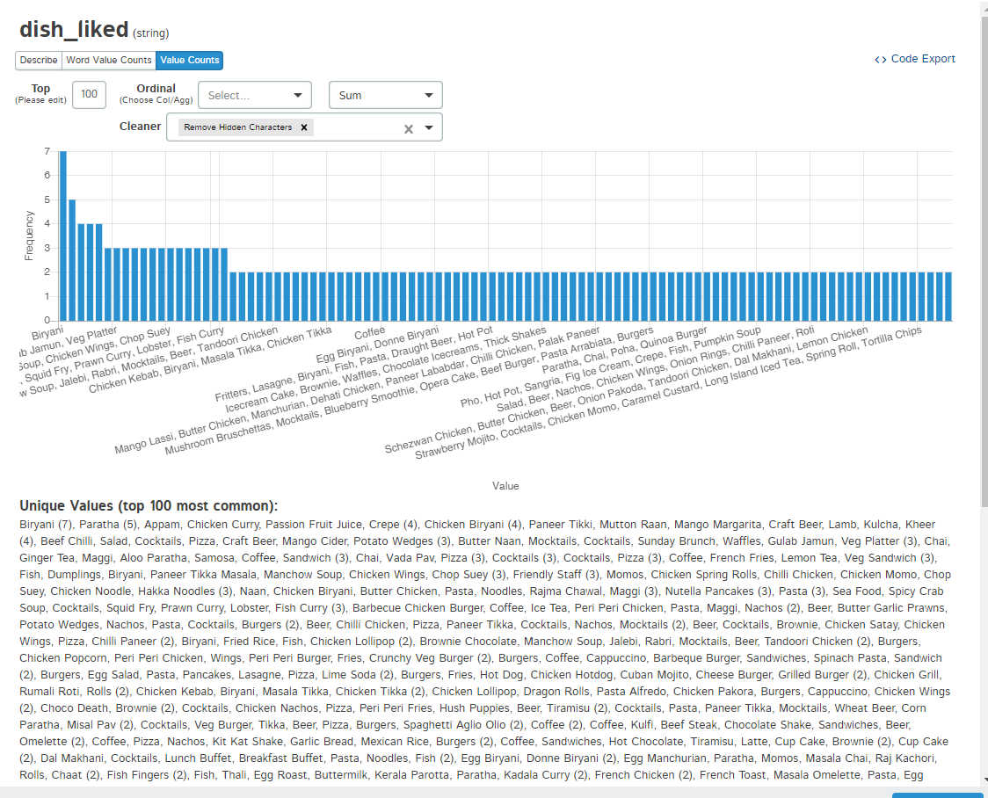
Dish Liked
Max Dishes like are –
Biryani,Paratha, Appam, Chicken Curry, Passion Fruit Juice, Crepe , Chicken Biryani,

Slide 14
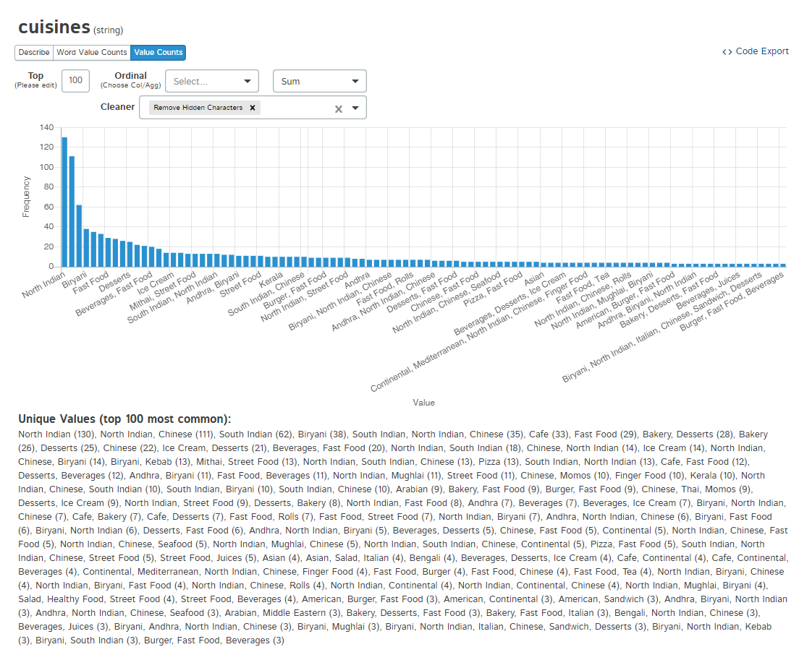
Cuisines
Top 3 type of cuisines are –
North Indian ,North indian and Chinese, South Indian

Slide 15
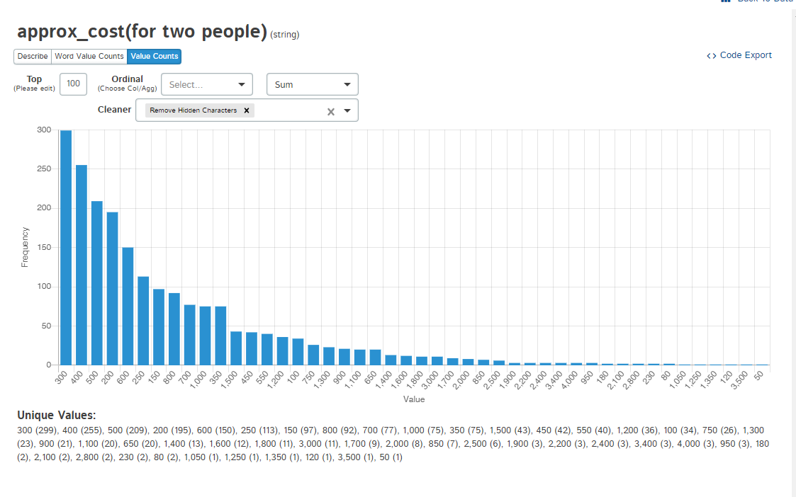
Approx Cost for two people
We See that 300,400,500 are approx. cost for 2 people

Slide 16
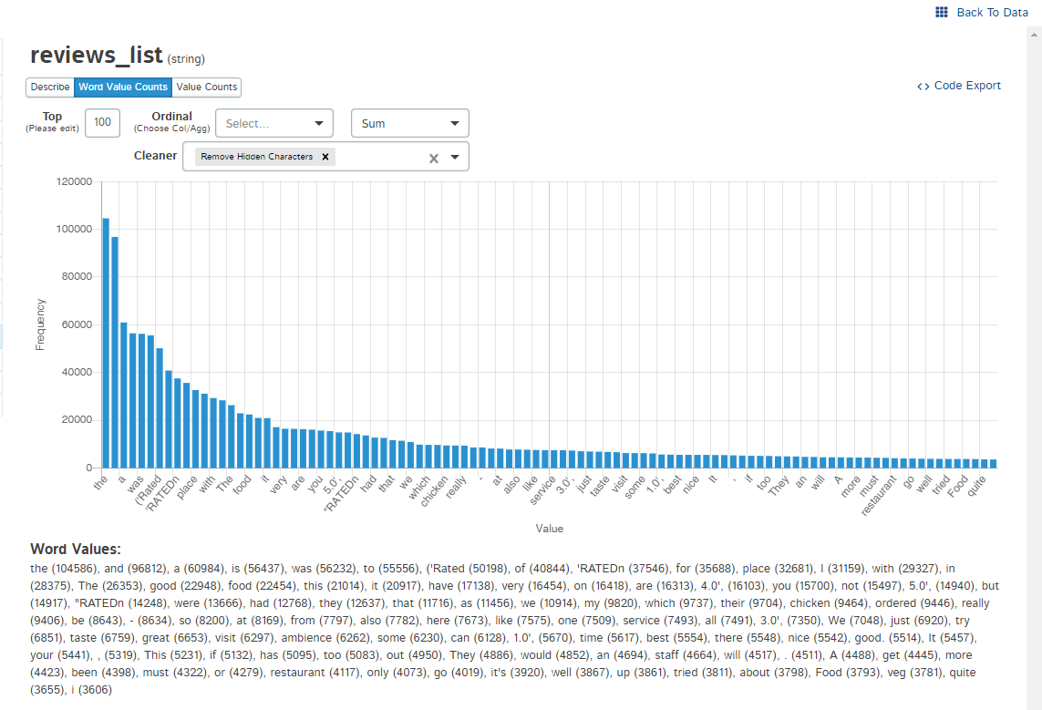
Reviews list
We Seen That There Are Max Stop words in reviews which are not useful for us so we remove stop words

Slide 17
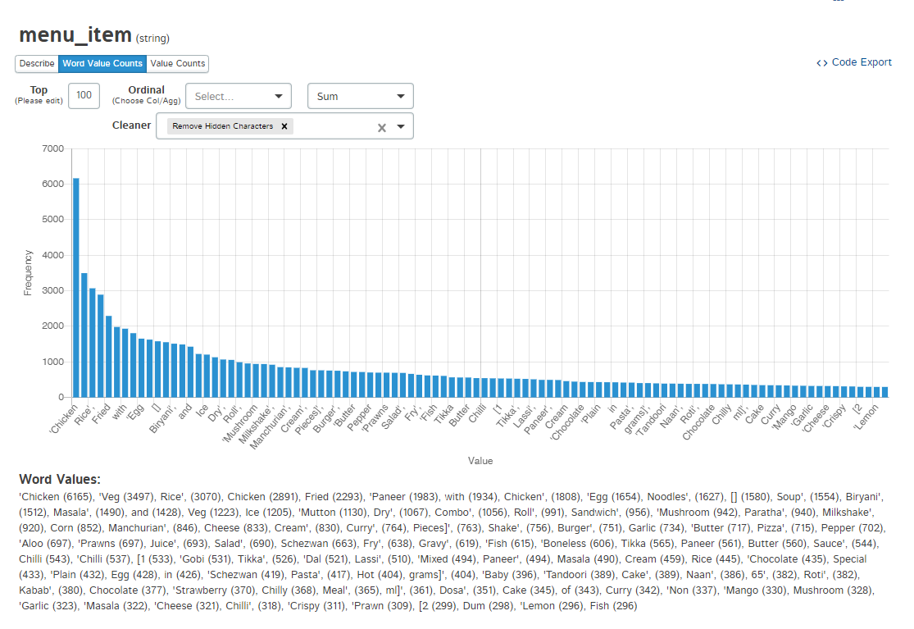
Menu Item
We Seen That In menu items for max restaurants have chicken,veg,rice etc

Slide 18
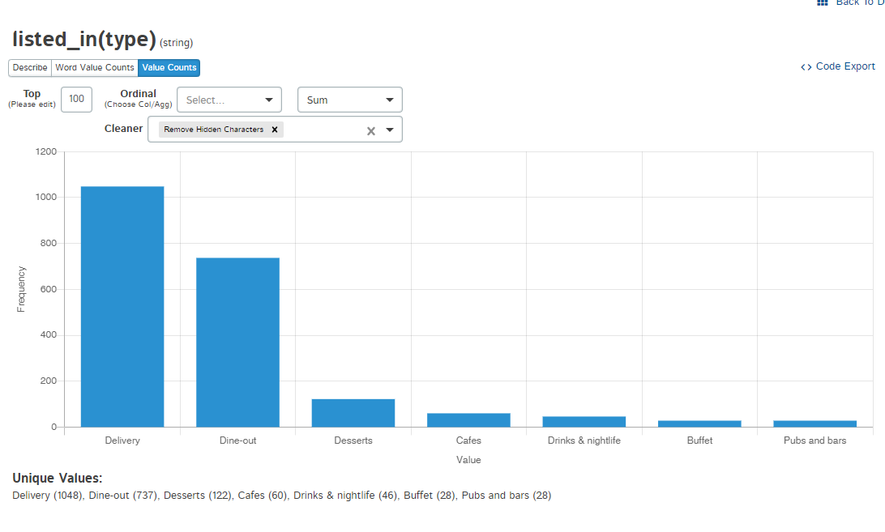
Listed_in(type)
We Seen that Amx Restaurants Provide delivery ,Dine-out,Desserts options

Slide 19
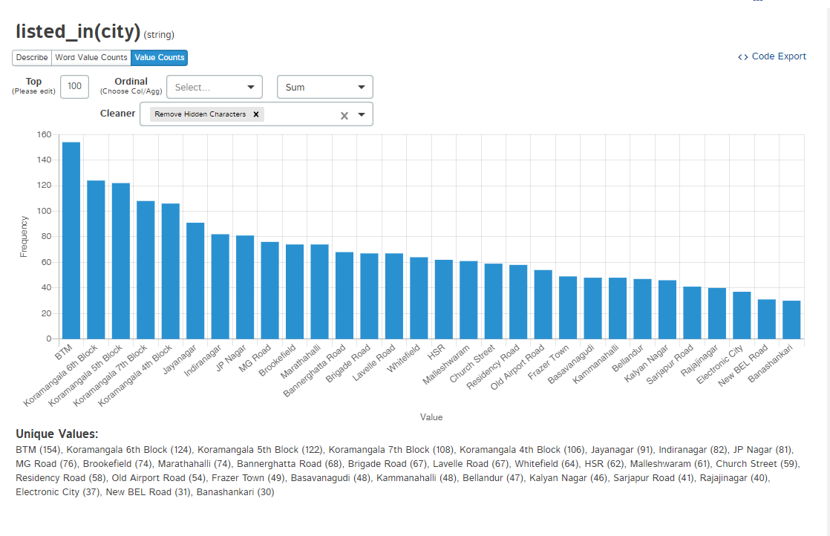
Listed_in_city
We Seen That In City BTM, Koramangala 6th Block, Koramangala 5th Block have highest value

Slide 20
Questions Answers
1. why you have implemented this solution using the algorithm you have used-
Because Algo provide nearest Neighbour ,very fast ,works better than other algo , having non parametric in nature ,based on similarity
2. Under what circumstances this algorithm will fail
Any new attribute added except training attribute3.
3.Given more time how can you improve the same solution​
We create diff kpi , do more eda , train model based on diff kpi , creating diff type of sparse matrix ,etc

Slide 21
The End

